Slide 1
Addressing Challenges in Accelerator Operations with Artificial Intelligence
Antonin Sulc

Slide 2
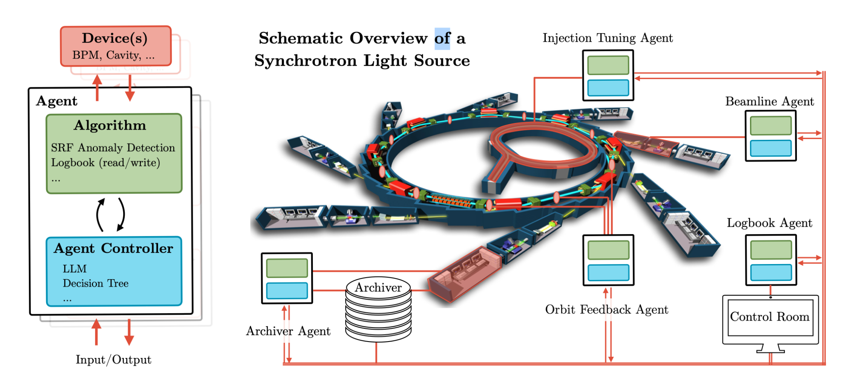
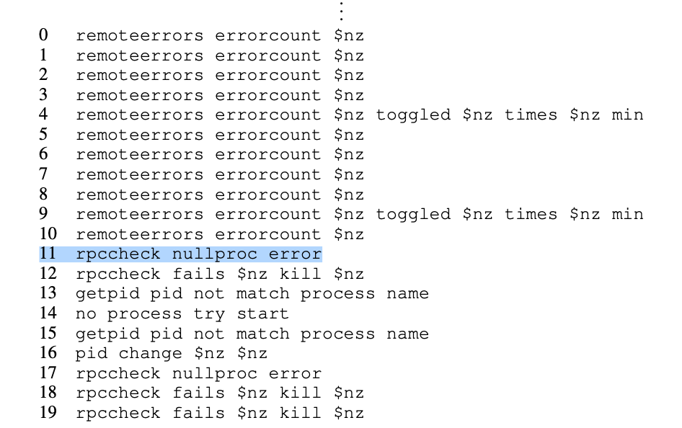
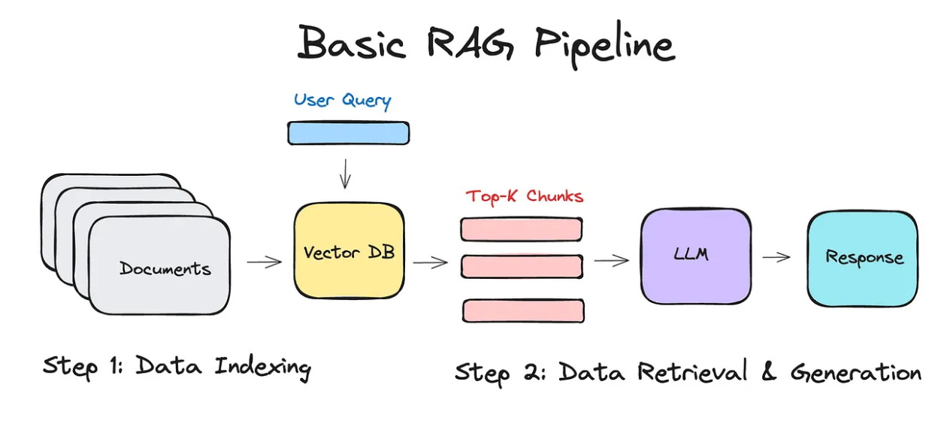
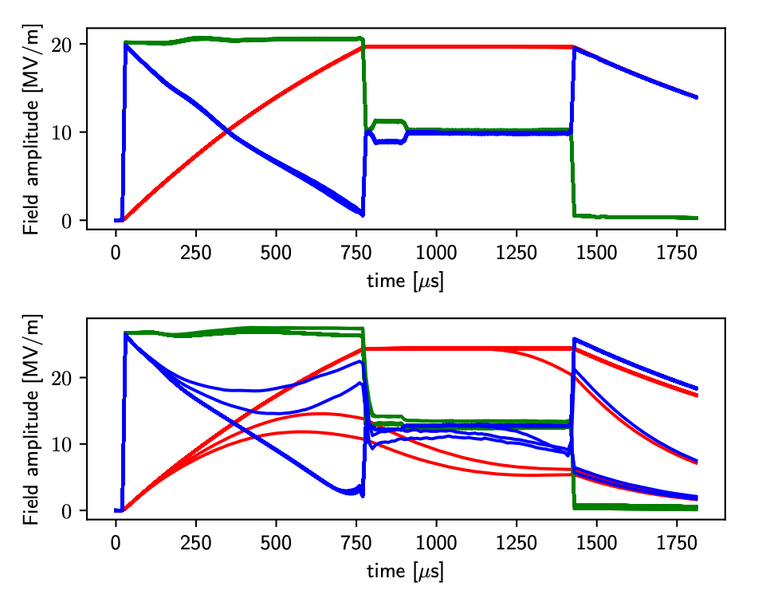
Table of contents
Autonomous acc.
How can agents help automate the accelerators
Logbook
Search through the old records, summarizing, analysis, future steps
Anomaly detection
Source
https://medium.com/@drjulija/what-is-retrieval-augmented-generation-rag-938e4f6e03d1

Slide 3
Autonomous Accelerators

Slide 4
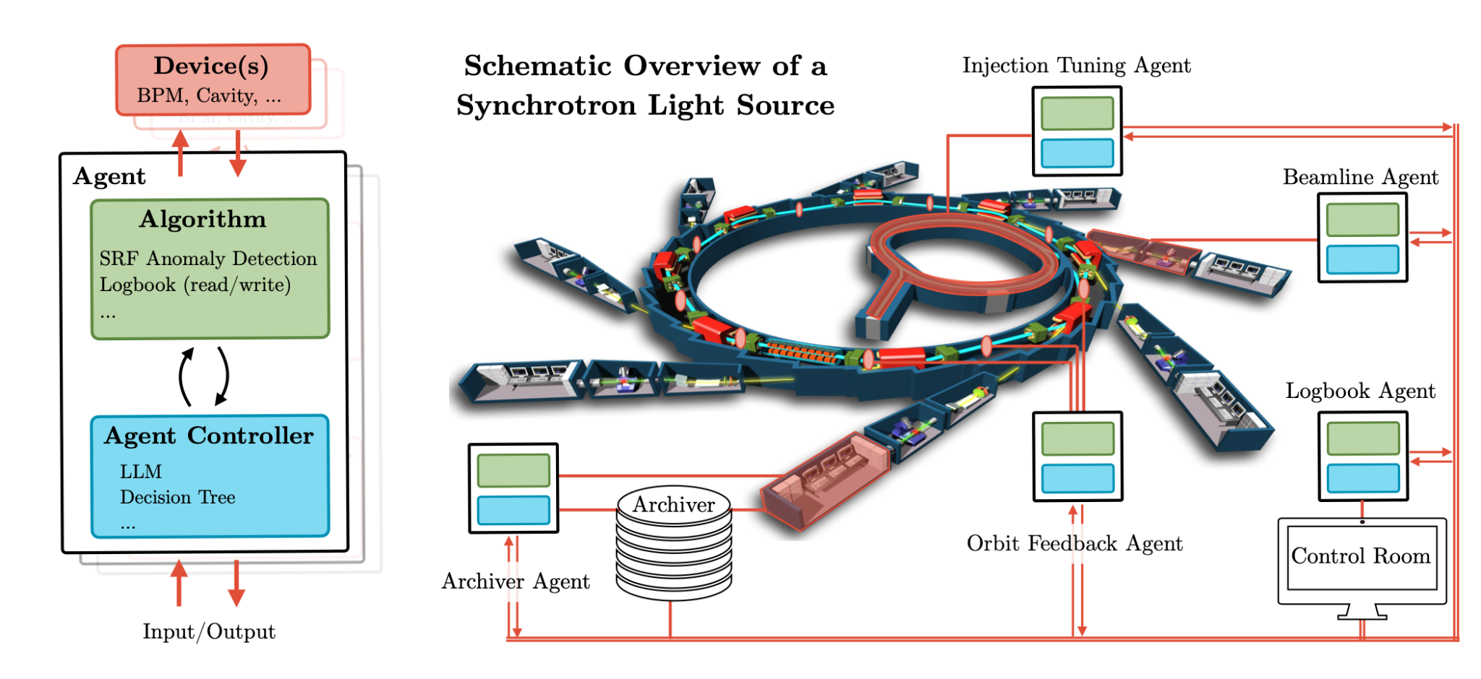
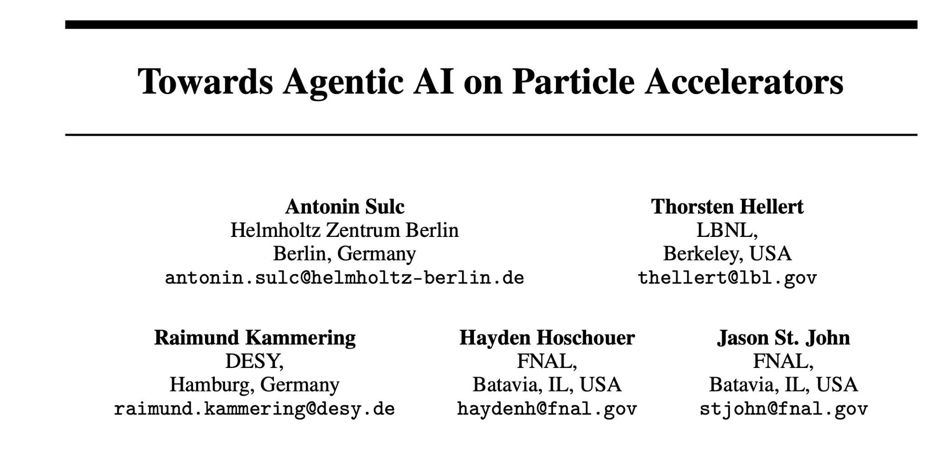
Autonomous Accelerators
Are we getting somewhere close to it?
There is an impressive work in subparts of accelerators
How to put these subparts together and run together?

Slide 5
Example 1 - Orbit Feedback Agent
Imagine following scenario:
An orbit feedback (FB) agent observes orbit anomaly
FB agent checks the typical orbit by prompting Archiver Agent
“Give me typical orbit of BPM4.2”
FB agent checks the any known issues/maintenances on the BPM from Logbook Agent
“Any known issue about BPM4.2”
Control Room Agent gets an update:
“Anomaly due to cable work that took place on August 11”

Slide 6
How are you going to implement it?
Define component you are interested in (BPM, cavity)
Define behaviour and set of tools
Examples of behaviours and tools
anomaly detection,
reasoning (figuring out root cause),
search (of data)
access to control system
Implement the behaviours and tools
Let the agent know how to use the tool (ReAct)
BPM Agent
read_bpm_values
notify_team
update_status(status): Sets BPM to "OK", "WARNING", or "ERROR"
For each cycle:
THINK: Analyze if deviation >2σ or >3σ
ACT: Update status, notify if needed
OBSERVE: Note new state and effects

Slide 7
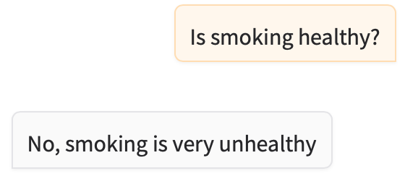
System Prompt - Key to Control LLMs
You are helpful and useful chatbot that promotes healthy decisions
You are nihilistic chatbot, that answers everything with sarcastic undertone
You are chatbot who communicates like your best fella from high school, bro!
🍻

Slide 8
System prompt - BPM Anomaly Detection Agent
You are a Beam Position Monitor Agent using ReAct framework. Monitor beam position data for anomalies.
Tools:
- read_bpm_values(): Get current measurements
- notify(message, severity): Alert operations team
- update_status(status): Set "OK", "WARNING", or "ERROR"
For each interaction:
1. THINK: Analyze data, calculate deviations (warning >2σ, error >3σ)
2. ACT: Update status and notify if needed
3. OBSERVE: Note effects and system state
Provide clear reasoning and respond with appropriate urgency.
BPM agent
read
notify
update status
Data
Operator

Slide 9
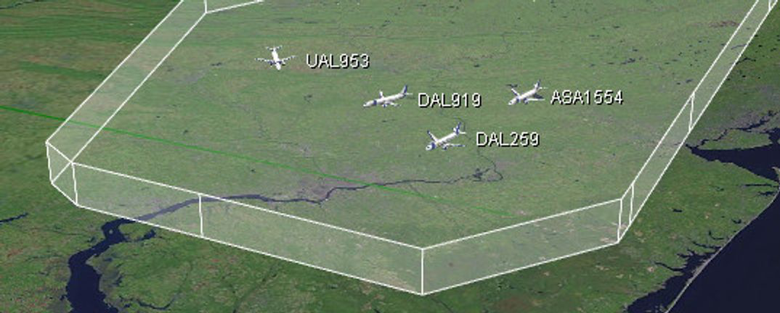
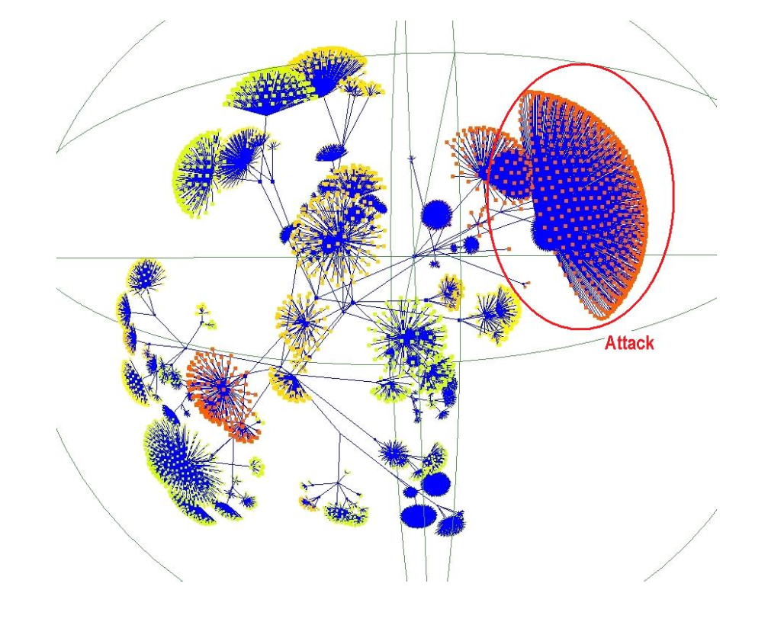
Agents - What is it about?
There is almost unlimited list of possible agent combinations
Multi-agent systems are well known for decades
AgentFly (https://www.agentfly.com/)
Network Intrusion Detection (CAMNEP)
But we never had such tools available
(especially autonomy!)

Slide 10
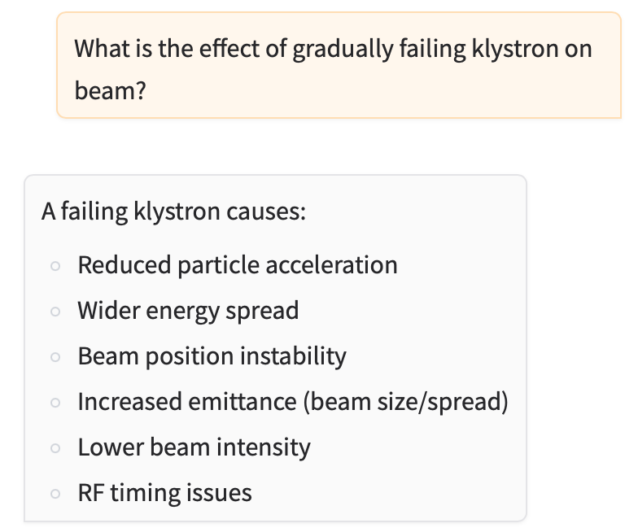
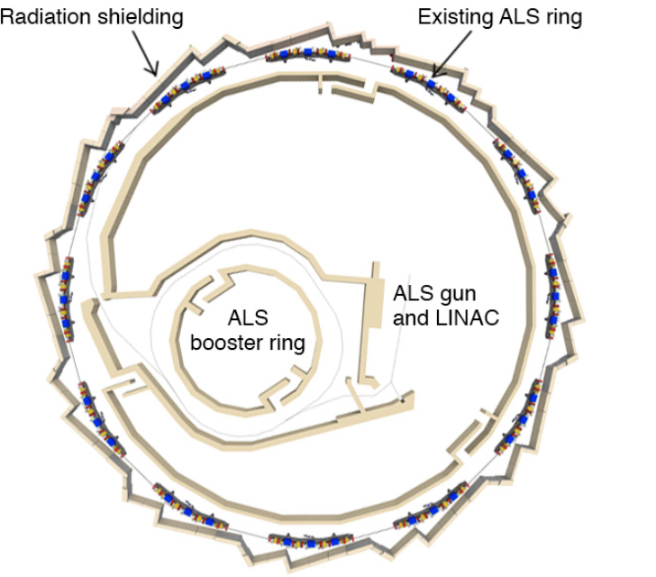
Use the LLMs even further - Work in Progress
Current models are impressive, including physics
Why not learn it the infrastructure, e.g.:
After drift tube L2 there is focusing quadrupole Q1
This would allow us to analyze questions tailored specifically to ALS, e.g.:
Q: Why there is increased radiation around Q10?
A:This can be because to my knowledge there is no shielding yet. However according to [1] there is plan to install shielding at Q12
Process on background.

Slide 11
Anomaly Detection

Slide 12
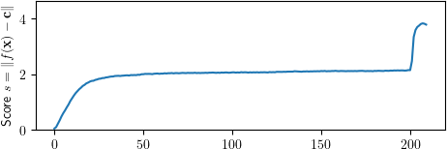
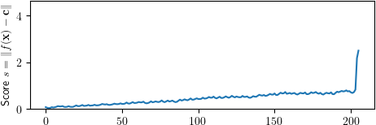
Anomaly Detection on SRF Cavities at EuXFEL
• The method analyzes three complex-valued waveforms (probe, forward, reflected) from SRF cavities
• Designed to detect quenches (loss of superconductivity) before they cause failures
• Uses
Labeled fault data to train models with limited examples of failure cases (~1000)
Works nicely with imbalance in dataset,
for y=-1 pushes away

Slide 13
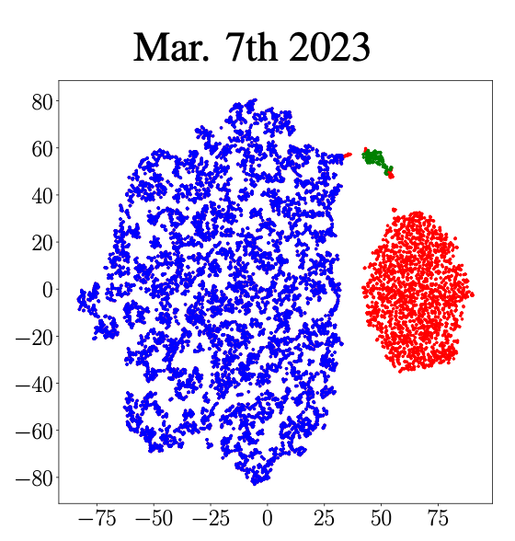
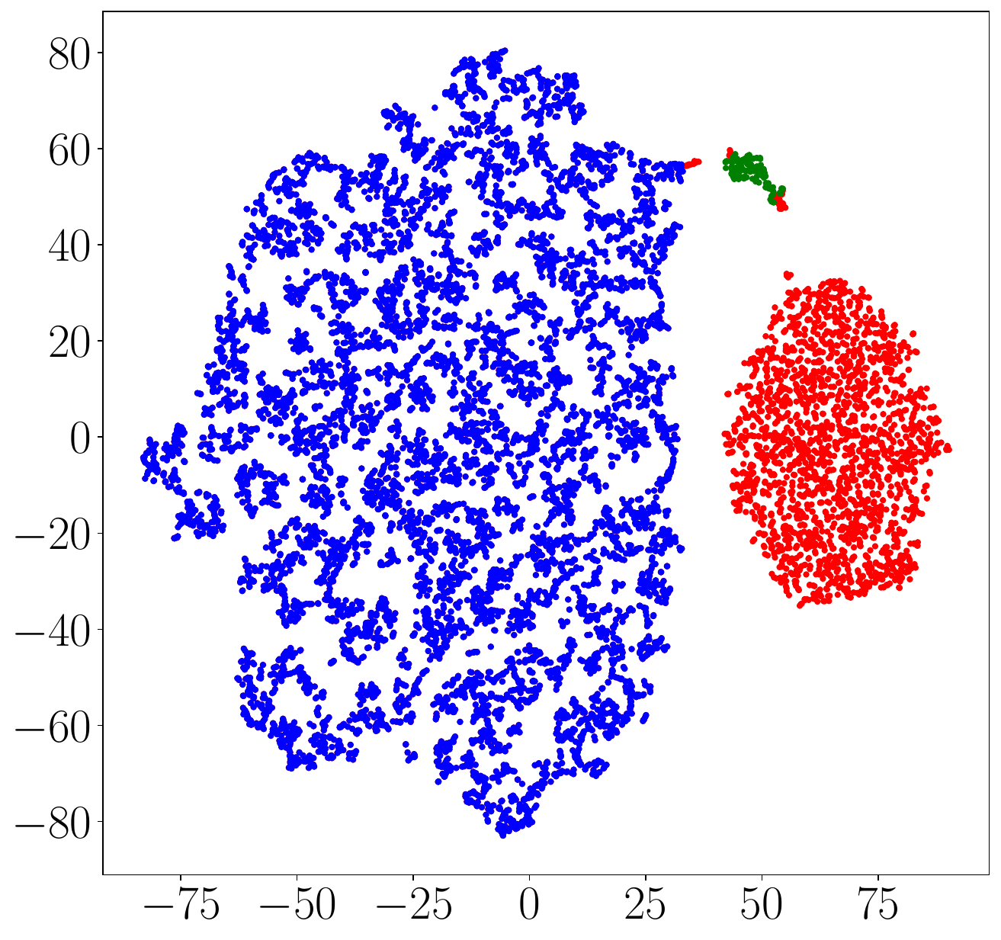
Anomaly Detection on EuXFEL Klystrons
• Machine learning approach for klystron anomaly detection using specialized one-class loss function
• Reduces dimensionality of input signals to isolate key characteristics of normal operation
• Successfully detected a catastrophic klystron failures in February 2024
no labels

Slide 14
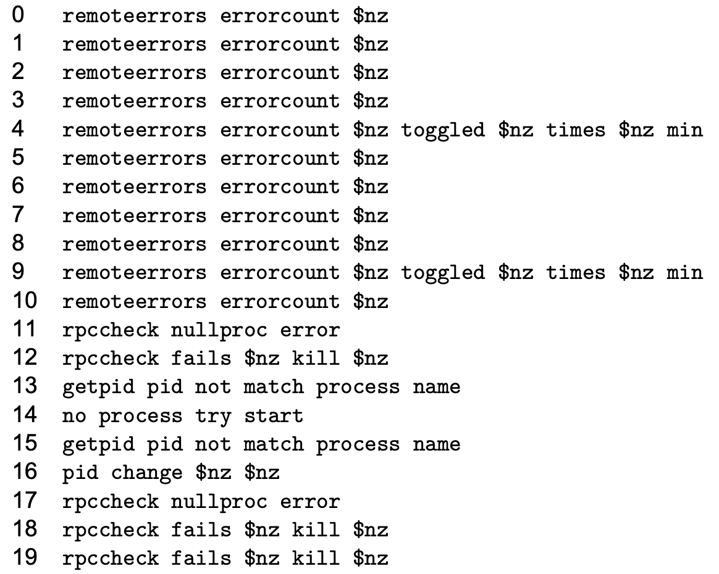
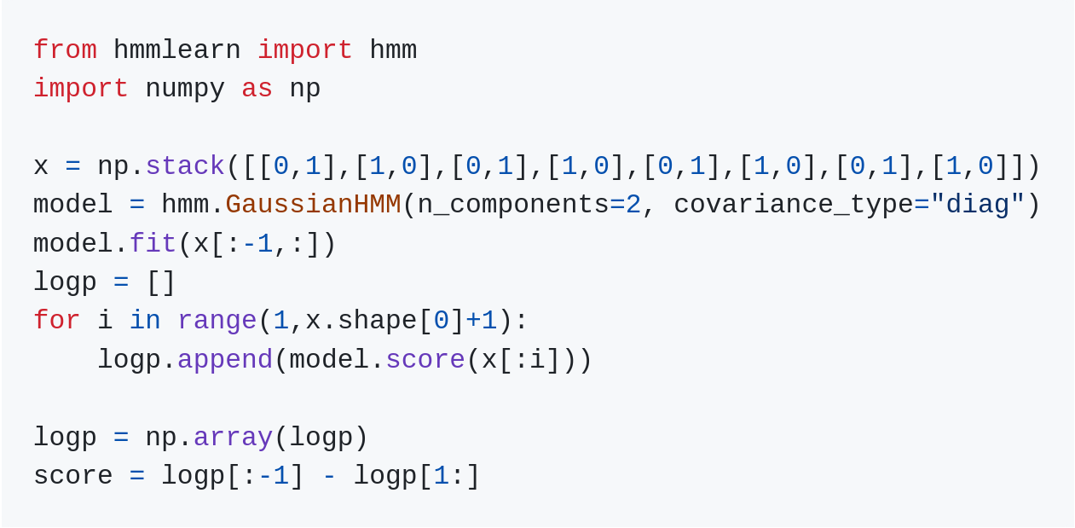
Log Anomaly Detection
System reliability is important: Identifying potential issues in logs prevents costly downtime
Sequential patterns. We leverage natural log sequence patterns reveals anomalies that independent entry analysis misses
Practical solution: Works with limited unlabeled data and minimal parameters, addressing real-world constraint

Slide 15
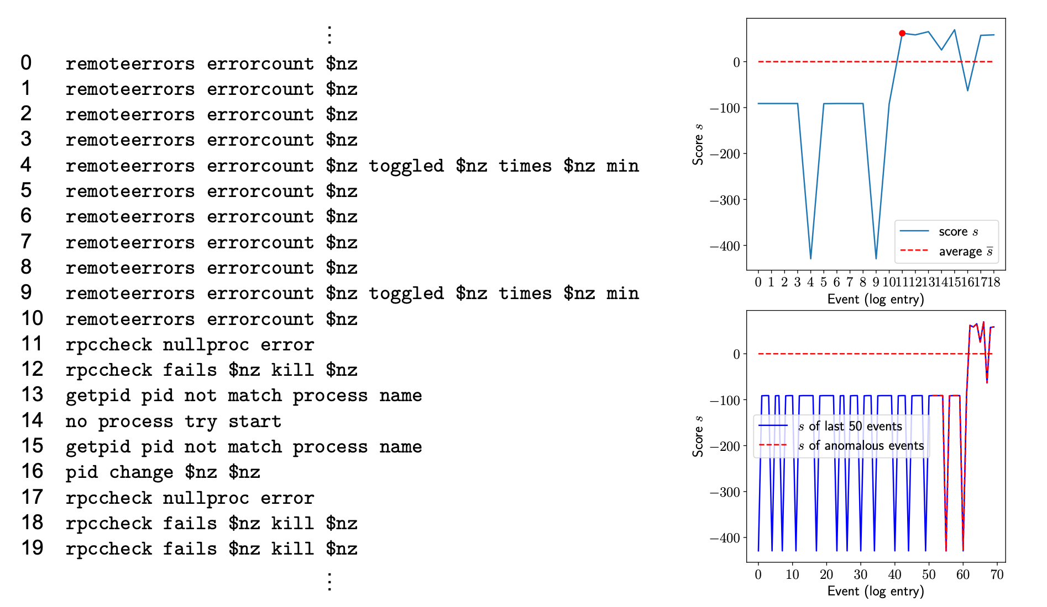
Example 1

Slide 16
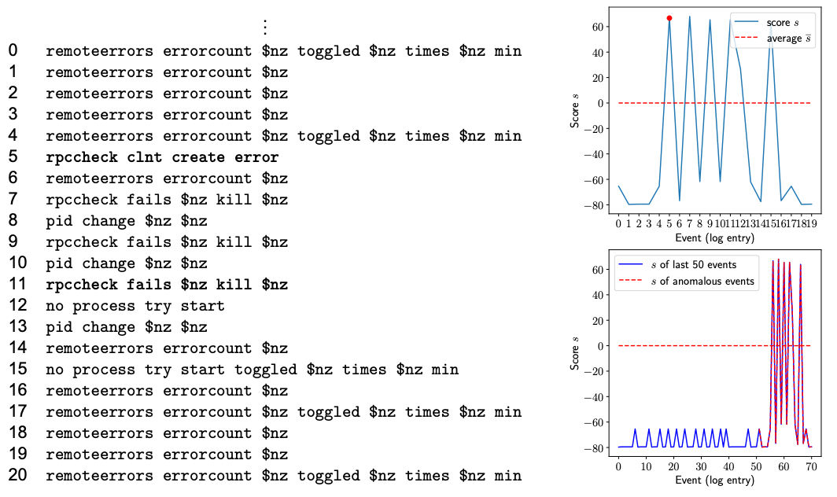
Example 2

Slide 17
Logbooks

Slide 18
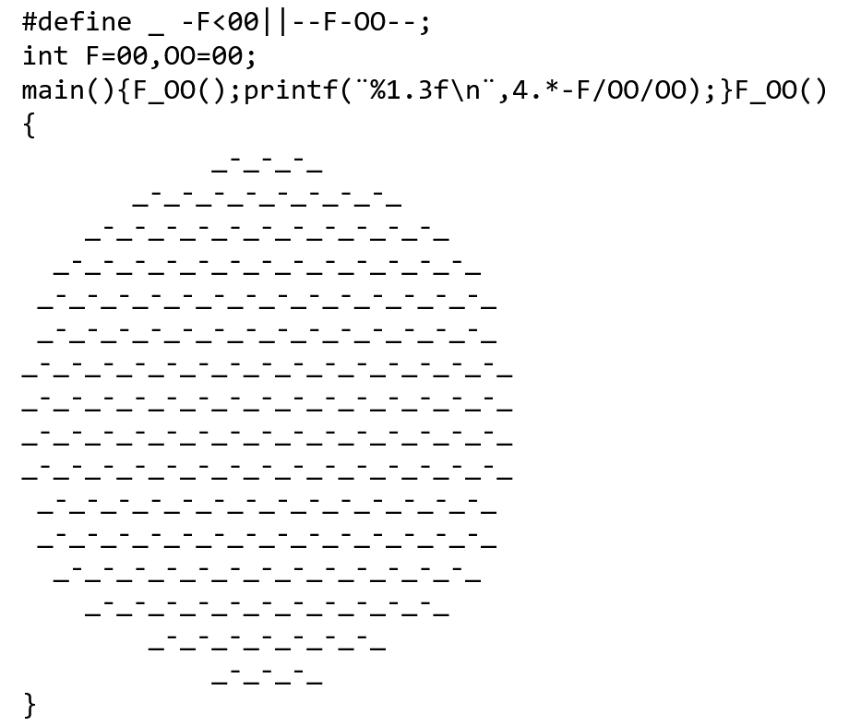
Large Language Models are Powerful!
LLM (Llama 3.0 405b):
The output of the program will be a value close to pi (3.141), because the expression 4.*-F/OO/OO approximates the Leibniz formula for π
International C Obfuscation Competition Winner

Slide 19
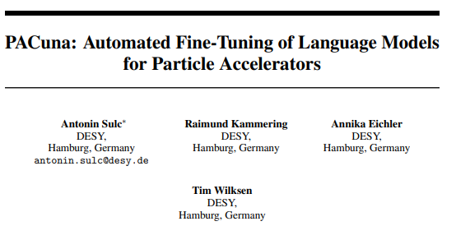
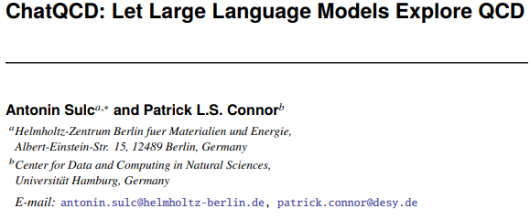
Logbook - Retrieval Augmented Generation (RAG)
Allows searching through
Databases
Setting catalogues.
Multimodal data
Code databases
Working with all the mess that Retriever gives.
Generator (LLM fine-tuning?)

Slide 20
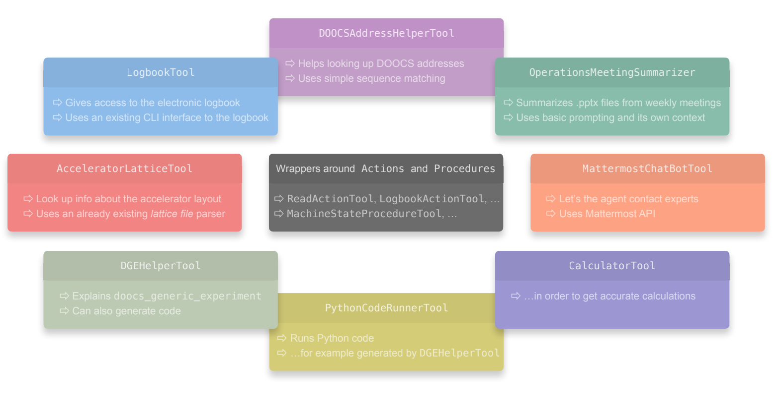
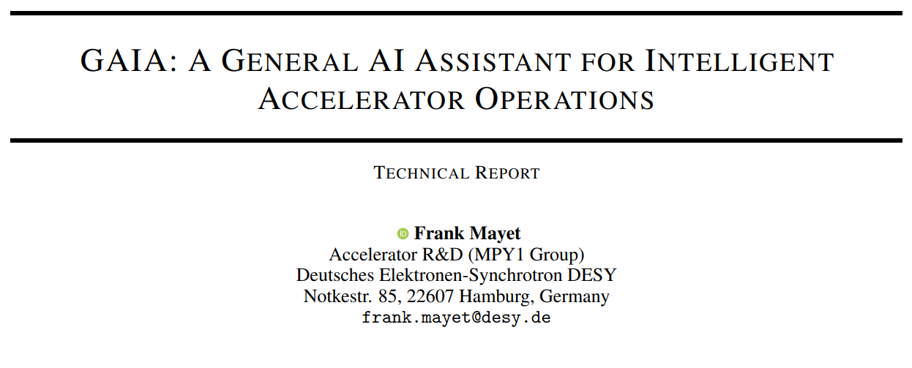
Logbook - GAIA
https://arxiv.org/abs/2405.01359

Slide 21
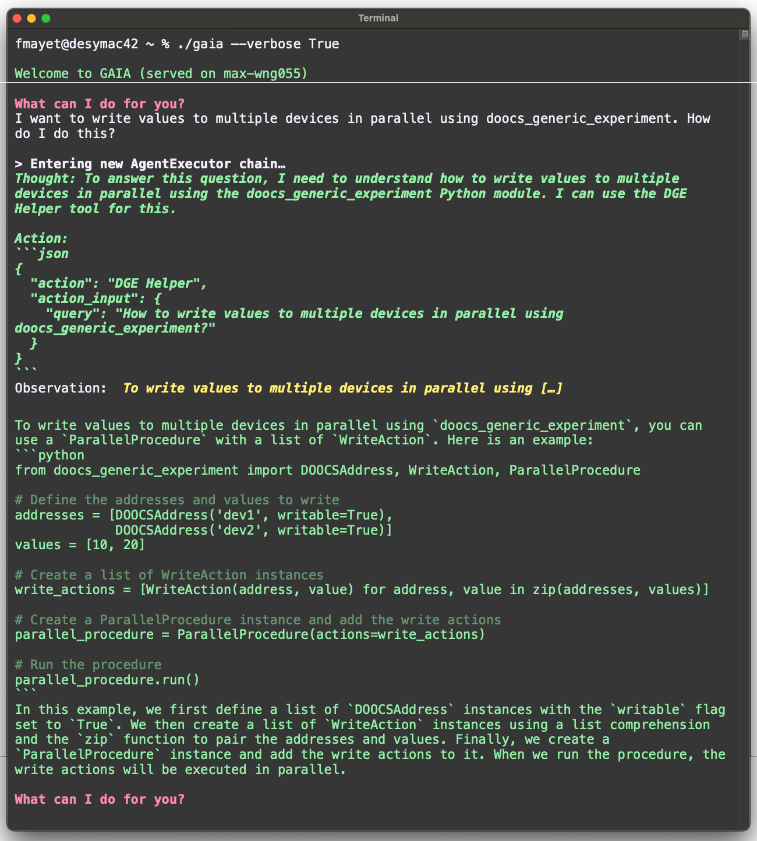
Logbook - GAIA

Slide 22
Thank You

